Slide 1
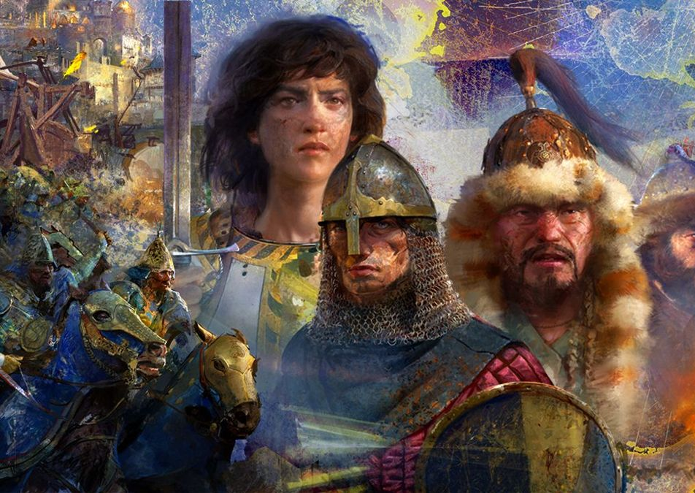
AOE4 Matchmaking System
A comprehensive matchmaking system for the RTS game Age of Empires IV using machine learning techniques
Presented by Sukhrob Ilyosbekov

Slide 2
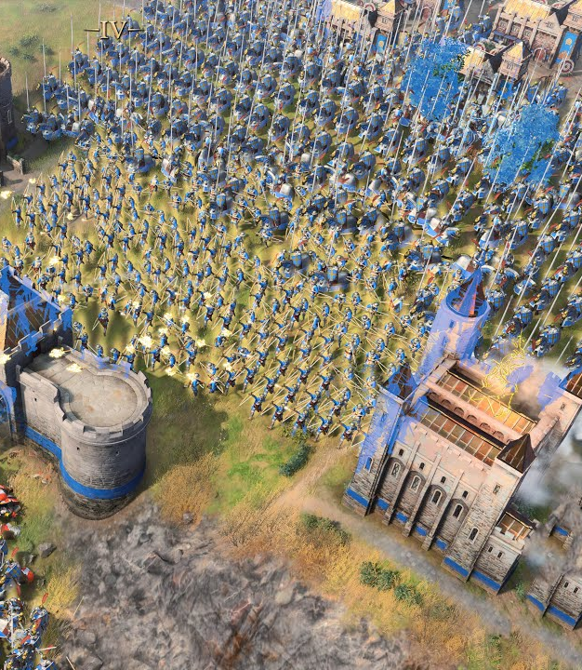
Project Overiew
What’s AoE4?
Brief introduction to AoE4 matchmaking challenges.
Objective: Fair, balanced matches using ML & Clustering.
Traditional matchmaking system vs ML based matchmaking system

Slide 3

Data & Features
Data sources: Player leaderboard & historical games from the https://aoe4world.com
The size of historical games is over 1 million games
Over 100k players data in the leaderboard dataset
Key features: rating, win rate, average MMR, last n games MMR difference, opponent’s average MMR
Clustering players into skill groups and rank levels: Conqueror, Diamond, Platinum, Gold, Silver and Bronze

Slide 4
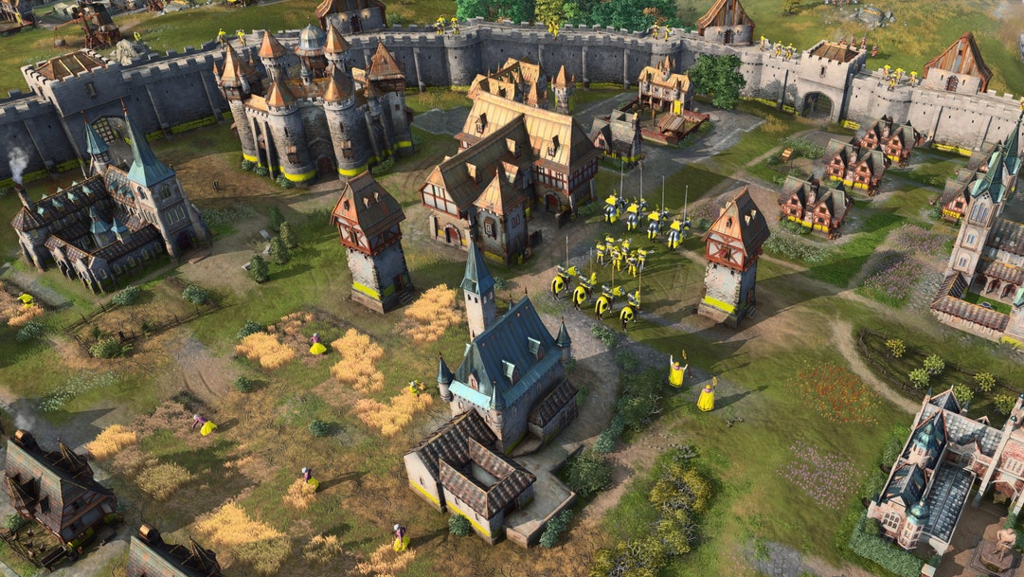
Modeling Approach
Classification model (XGBoostClassifier) to predict match outcome probabilities.
Clustering (KMeans) for grouping similar players.
Fallback ELO logic for unmatched scenarios.

Slide 5
Model Training & Tuning
Data preprocessing & feature engineering steps.
Hyperparameter tuning using RandomizedSearchCV.
Performance metrics: Accuracy, AUC.
Try other models such as LogisticsRegression, RandomForestClassifier and HDSCAN for clustering
Save models to use in API

Slide 6
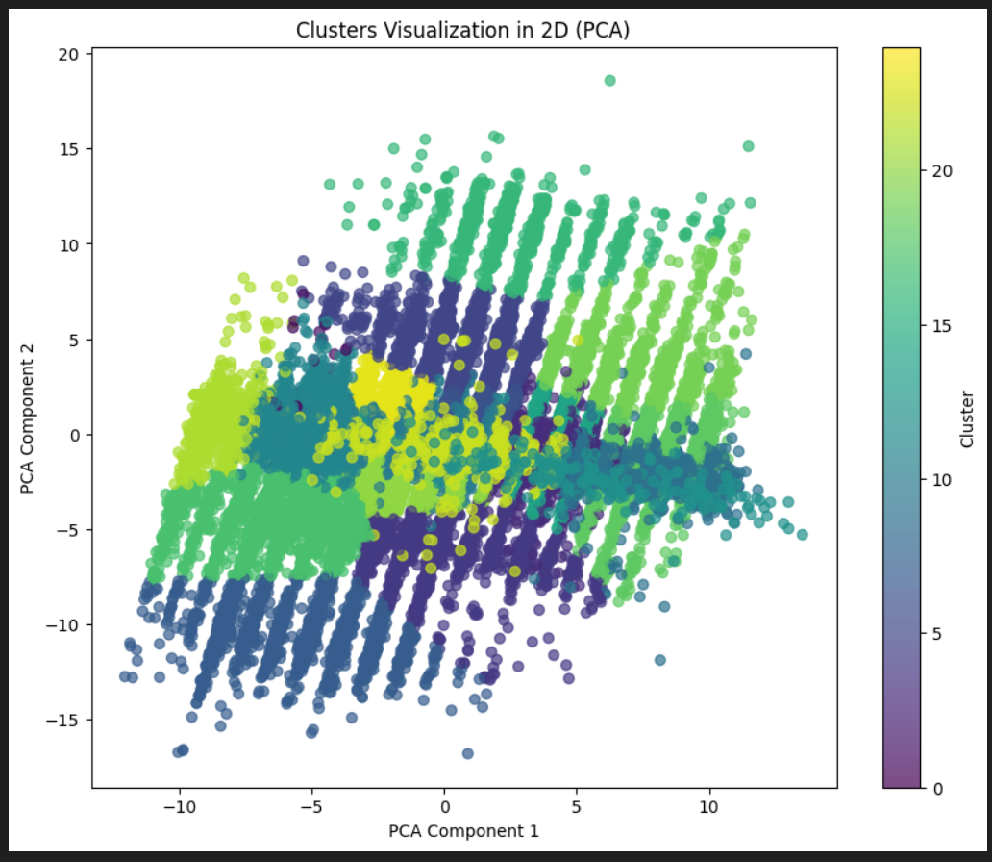
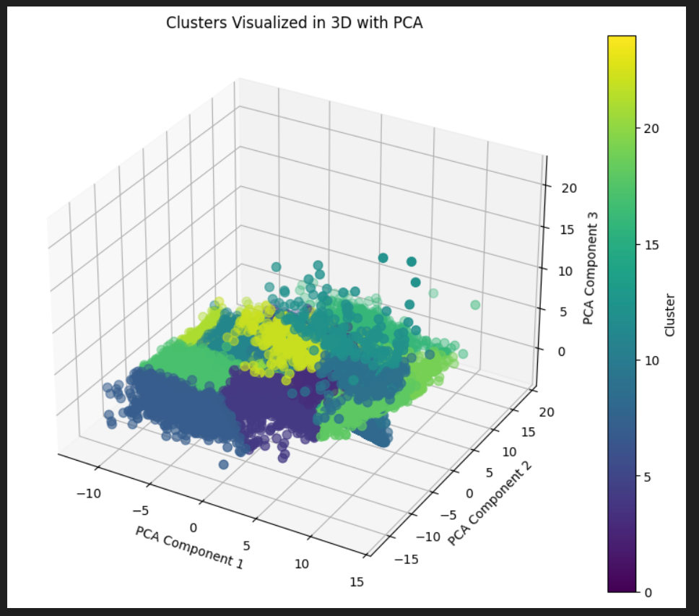
Results: Clustering

Slide 7
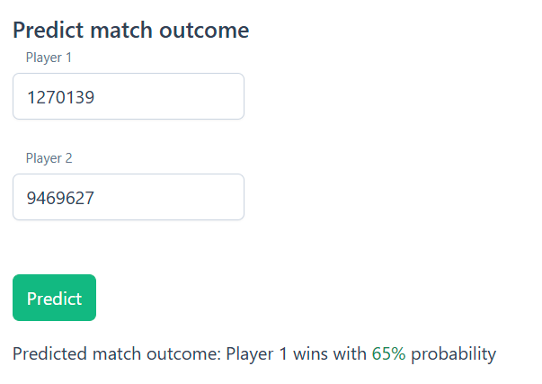
Results: Classification, predict match outcome
XGBClassifier: AUC accuracy: 73% after hyperparameter tuning
RandomForestClassifier: 70%
LogisticsRegression: 72%

Slide 8
System Architecture and Matchmaking Flow
Frontend app (Angular) -> Backend app (FastAPI) -> ML models
Matchmaking flow: Player joins queue -> Find match using clustering -> Predict Outcome -> if outcome around 50% then opponent found otherwise continue to find
If could not find best partner using cluster then use traditional ELO system as fallback option to find opponent

Slide 9
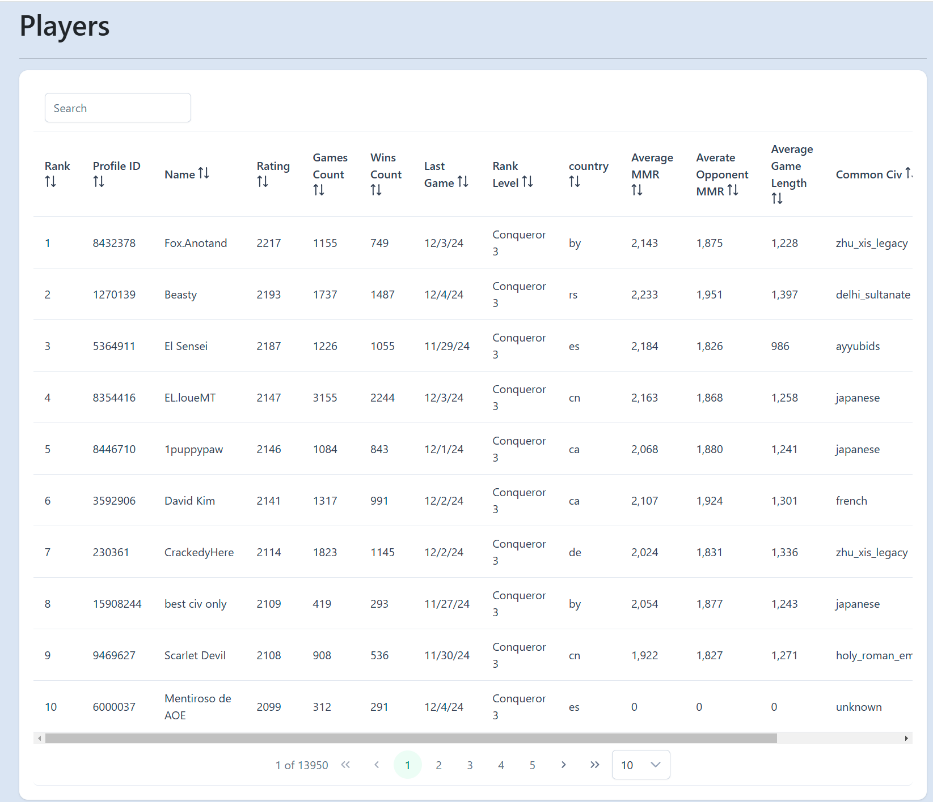
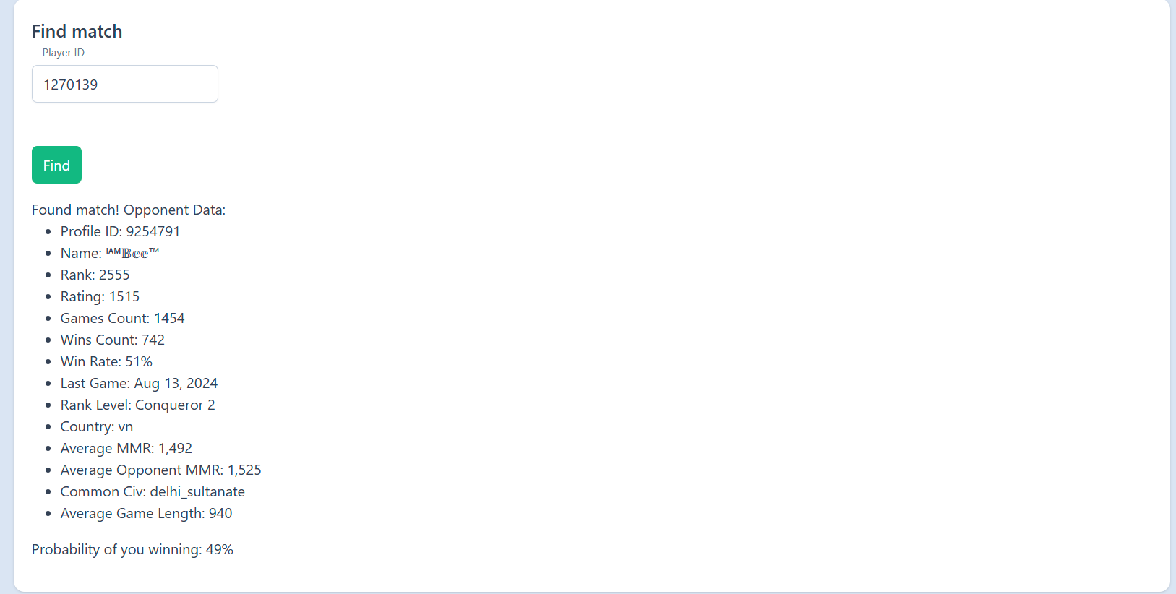
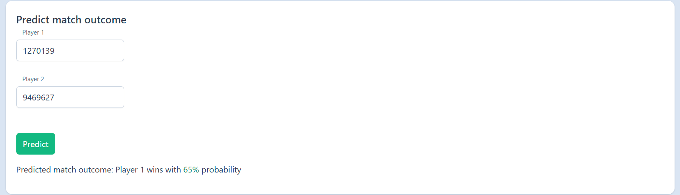
Demo

Slide 10
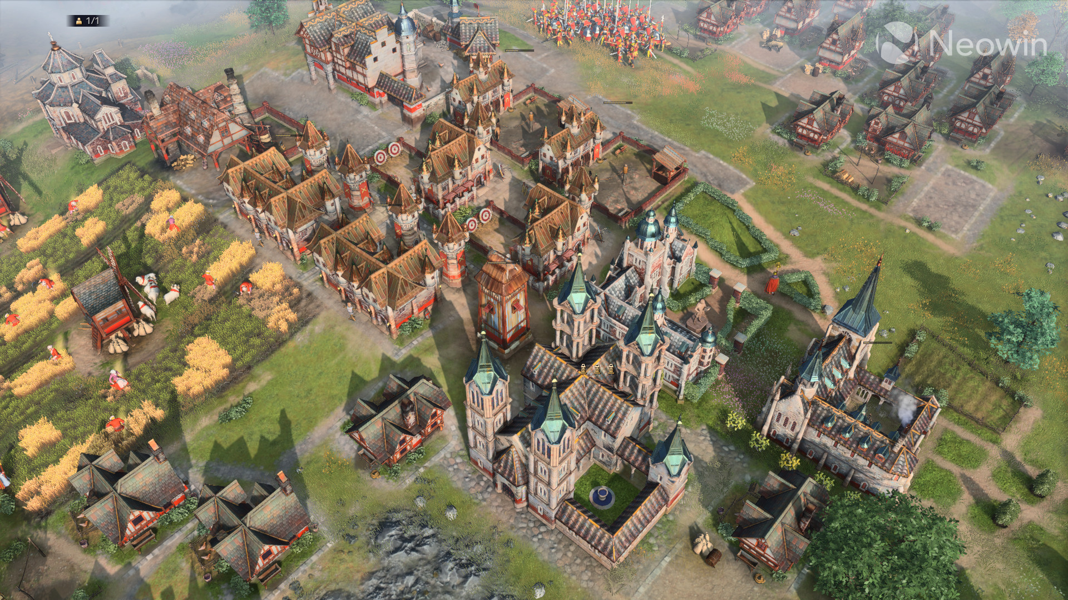
Thank You
The project is available in the GitHub repository:
https://github.com/suxrobGM/aoe4-matchmaking

